Slide 1
Deep Learning
Project proposals
Choose the projects here

Slide 2
Reading group on generalization
Context:
Research team in Bitdefender on this topic: https://bit-ml.github.io/
CoLLAs - Conference on Lifelong Learning Agents - Small conference, but very targeted, leading to meaningful/productive interactions
Next year most likely it will be organized in Romania https://lifelong-ml.cc/ (Razvan Pascanu is in the board)
Reading group:
0.5-1 paper/week
In person @UB
Fill this form until tomorrow 23:59 if you commit to participate in at least in 4 out of the first 5 meetings.
If there is enough interest, we will write back to you to decide together the details!

Slide 3
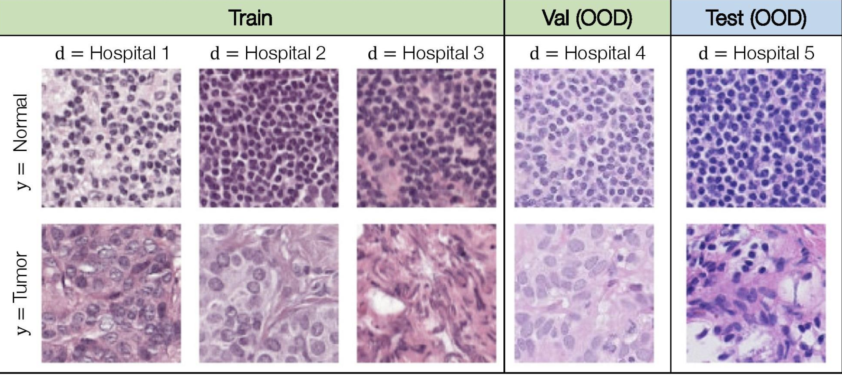
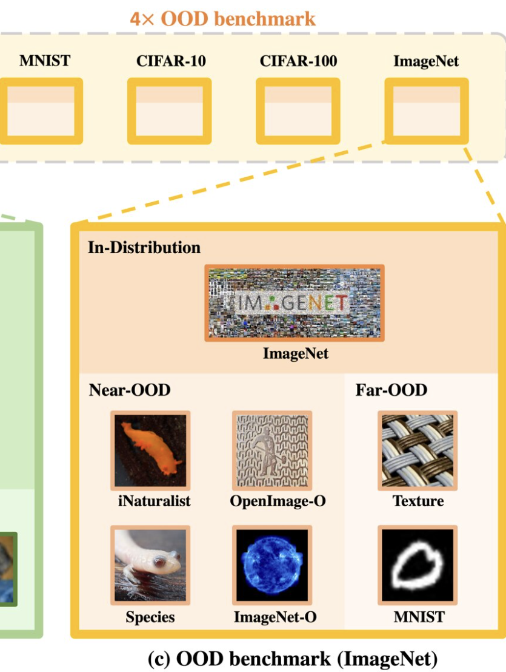
Out-of-Distribution Detection
Why it matters:
Avoid prediction on unfamiliar data: identifying unknown inputs can prevent dangerous decisions (e.g. healthcare, autonomous driving)
References: OpenOOD benchmark, FS-OOD benchmark
Datasets:
ID: ImageNetV2 or Tiny ImageNet
Near-OOD, Far-OOD
Methods: Energy OOD, DICE, SCALE, FDBD (various, based on: distance, density, classif.)
Compare several existing methods
(optional, HARD) Improve over them
Medium -> HARD (EEML)
eburceanu@bitdefender.com

Slide 4
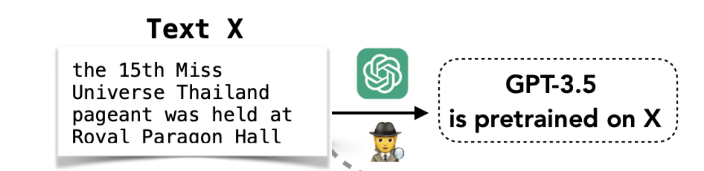
Fingerprinting LLM Training Data
Task: detect if a LLM was trained on my document
Dataset: MIMIR
LLM Models: Pythia (16 LLMs; public data; 70M-12B params)
Models: e.g. Loss, zlib, Min-K% Prob, MIA-based methods
Compare several existing methods
(optional, SF) Improve over them
References:
https://arxiv.org/abs/2310.15007
https://swj0419.github.io/detect-pretrain.github.io/
https://arxiv.org/abs/2406.06443
https://arxiv.org/abs/2406.17975
https://openreview.net/forum?id=PAWQvrForJ
https://openreview.net/forum?id=av0D19pSkU#discussion
Medium -> SF (EEML)
eburceanu@bitdefender.com

Slide 5
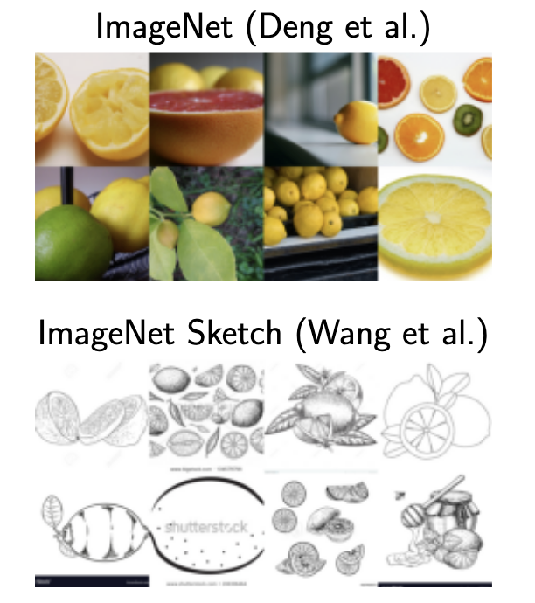
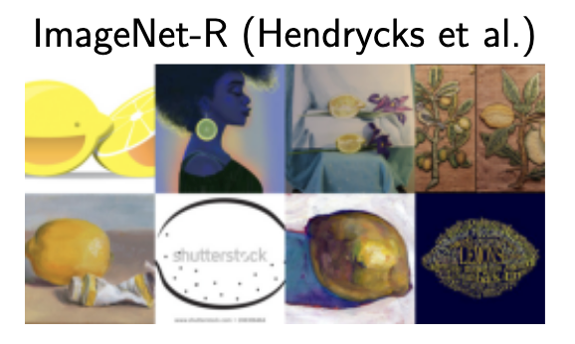
Imagenet Fine-tuning and OOD Generalization
Description: Start with pretrained models (e.g. from torchvision or huggingface). Prevent the model from losing its generalization capabilities.
Setup: Train on: ImageNet(validation / V2). Test on: ImageNet-A, ImageNet-R, ImageNet-S.
Tasks:
Compare several existing methods: (Medium) WiSE-FT, (Medium) LP-FT, (HARD) SAFT
(optional, HARD) Try to (marginally) improve existing approaches
HARD (EEML)
HARD
ext-abarbalau@bitdefender.com

Slide 6
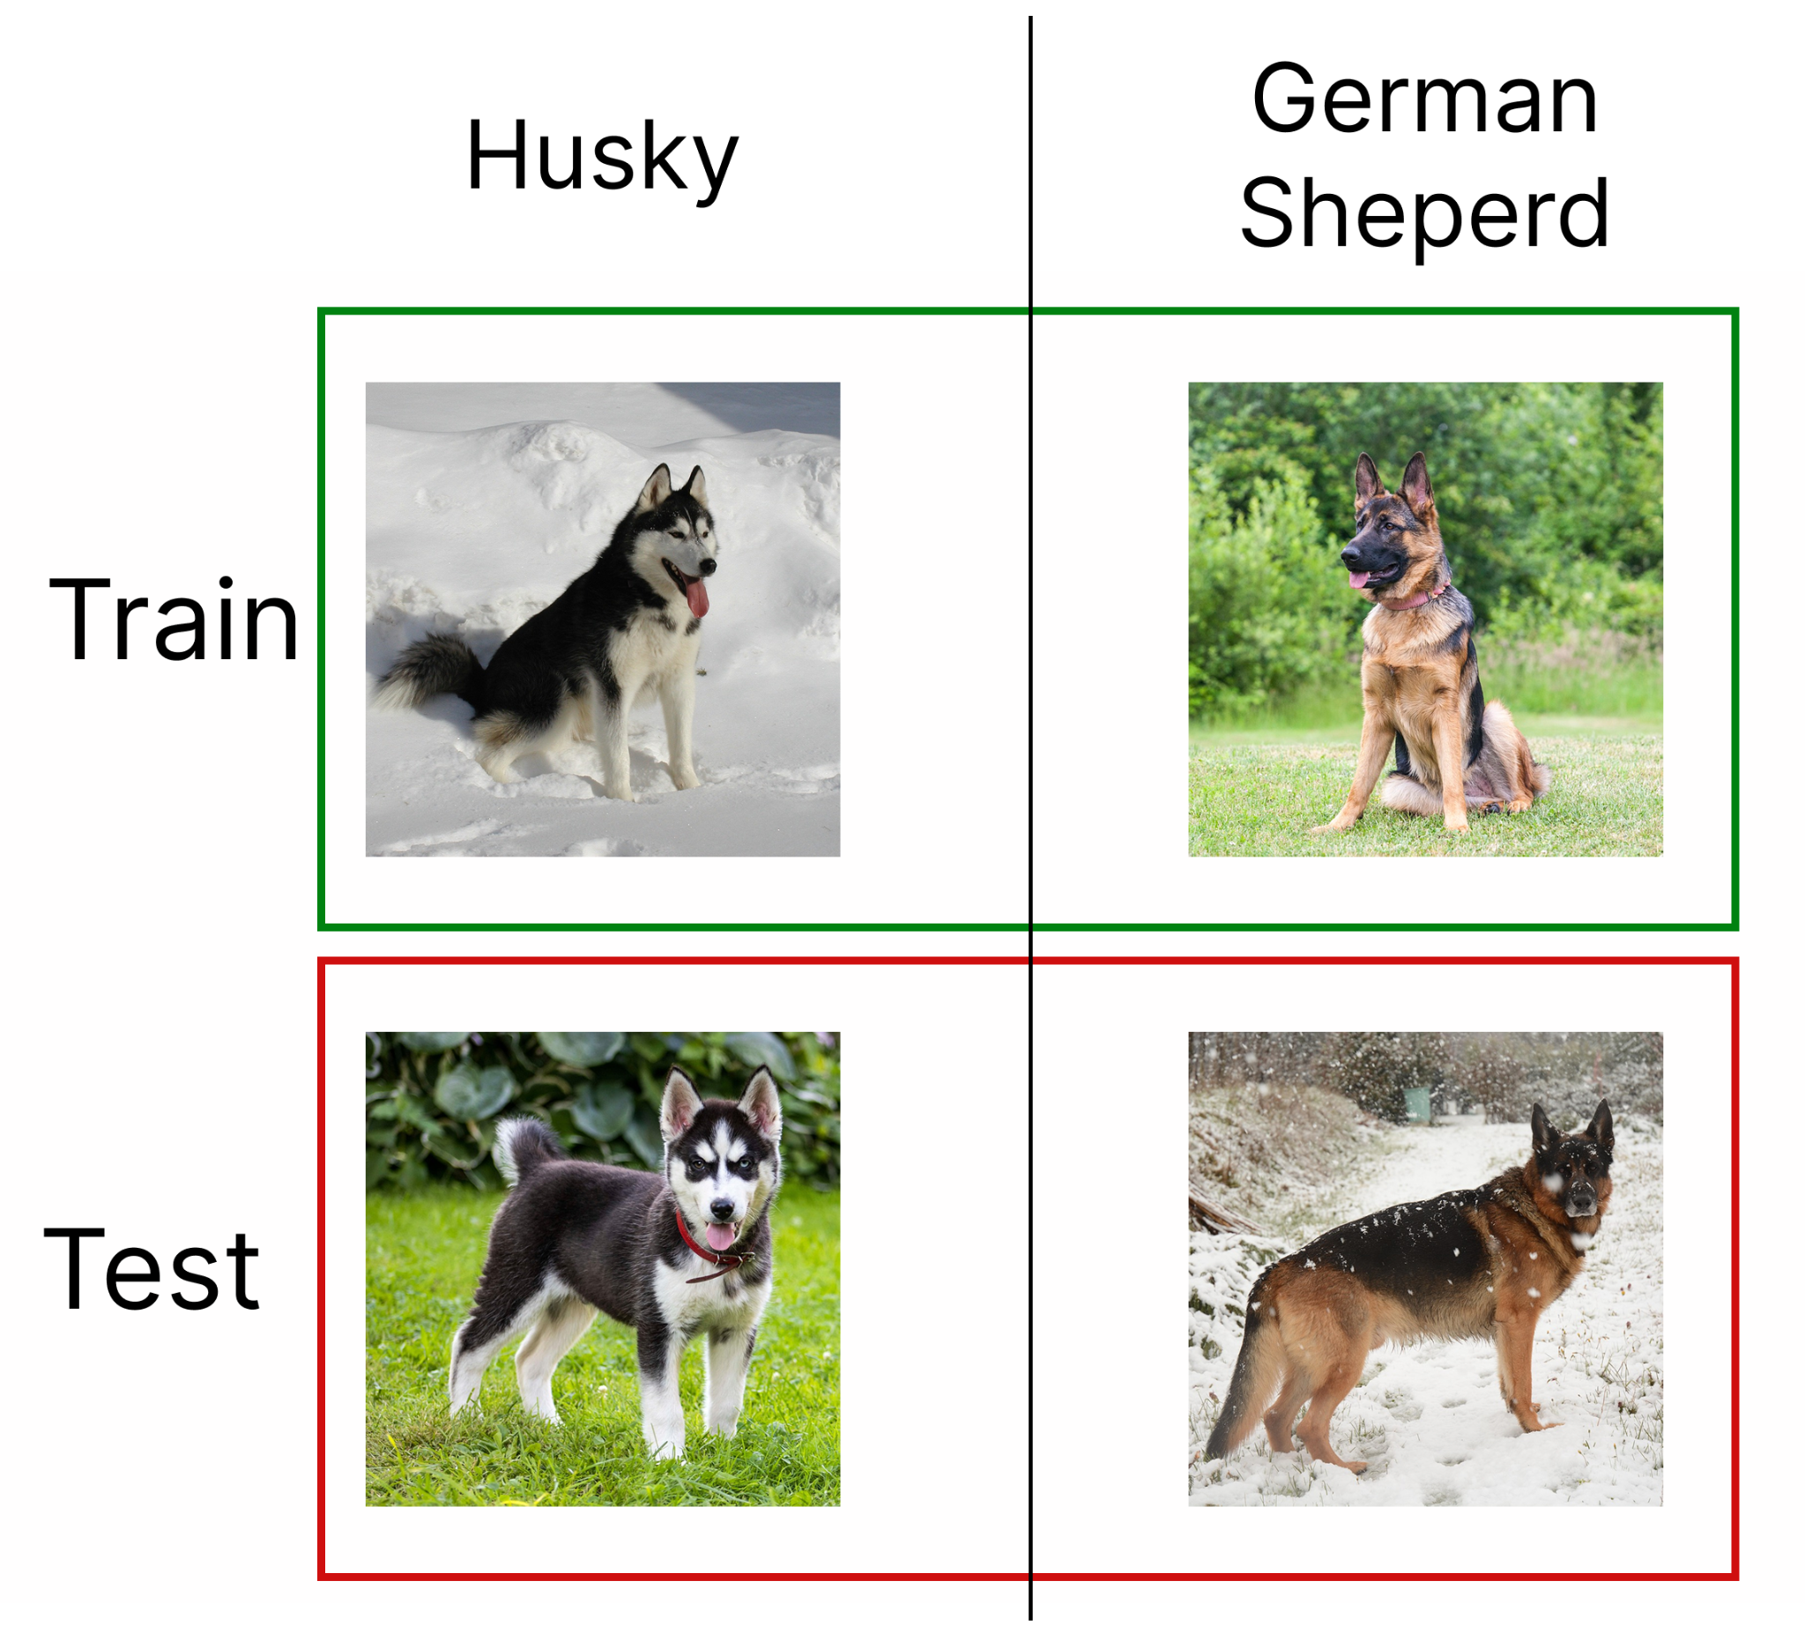
Spurious Correlations Identification
Task: Reproduce WASP and apply it for text classification datasets
Text datasets: Offensive social media posts, Fake News, etc.
Foundation Model: GTE, or any other models for text retrieval
Steps:
Identify possible SCs learned from the chosen dataset(s)
Validate that classifiers trained with ERM (LP & fine-tuned encoder) are affected by the identified SCs
Retrain the classifiers and make them more robust to the identified SCs (e.g. using GDRO, Resampling or other methods)
(optional) Use/propose other scoring methods, make ablations
(optional) Use other methods for SCI (e.g. Lg, B2T)
Grading:
70% for analyzing one dataset
100% for two or more datasets
HARD
HARD (EEML)
cpaduraru@bitdefender.com

Slide 7

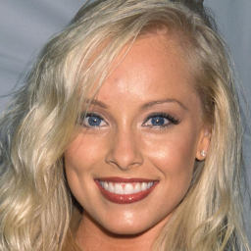
Deep Fake Image Detection
Real/Fake?
Task
Test different backbone architectures for deep fake detection of face images. Check how the models trained to detect a particular type of fakes transfer to other generation methods. (e.g. models trained on gan-generated images transfer to diffusion-generated images).
Adapt DeCLIP model for image detection and compare results with other SOTA deepfake image detection models
Datasets
CelebAHQ
StyleGan2 sampled images
LDM sampled images
P2 sampled images
Links
CNN-generated images are surprisingly easy to spot... for now
Are GAN generated images easy to detect? A critical analysis of the state-of-the-art.
What makes fake images detectable? Understanding properties that generalize
Towards the detection of diffusion model deepfakes
MEDIUM
eoneata@bitdefender.com, ssmeu@bitdefender.com

Slide 8
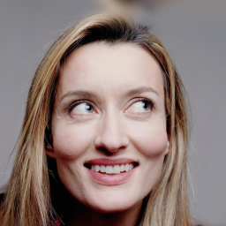
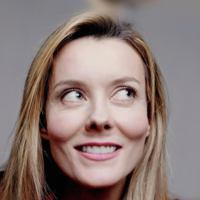
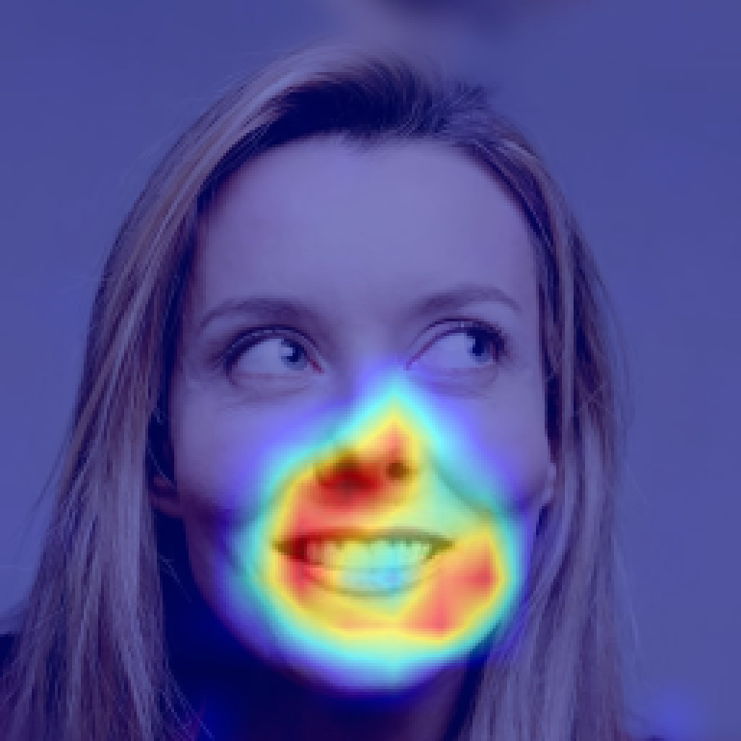
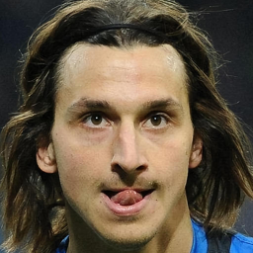
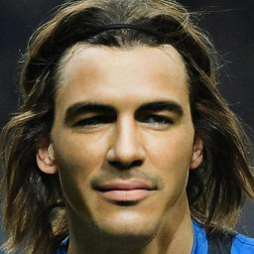
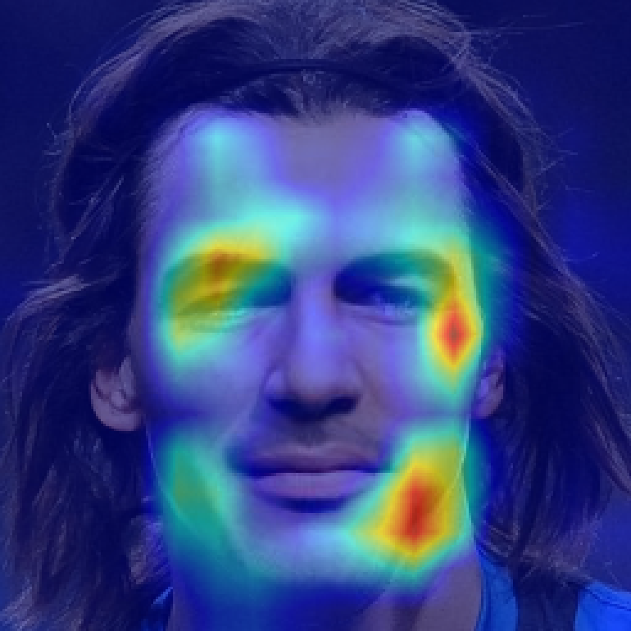
Deep Fake Localization
Task
Localize manipulated regions in images. You will experiment with different architectures for manipulation segmentation and analyze how results transfer from one deep fake generation method to another.
Datasets
Repaint
LAMA
Pluralistic
Links
CNN-generated images are surprisingly easy to spot... for now
Are GAN generated images easy to detect? A critical analysis of the state-of-the-art.
What makes fake images detectable? Understanding properties that generalize
Towards the detection of diffusion model deepfakes
MEDIUM
eoneata@bitdefender.com

Slide 9
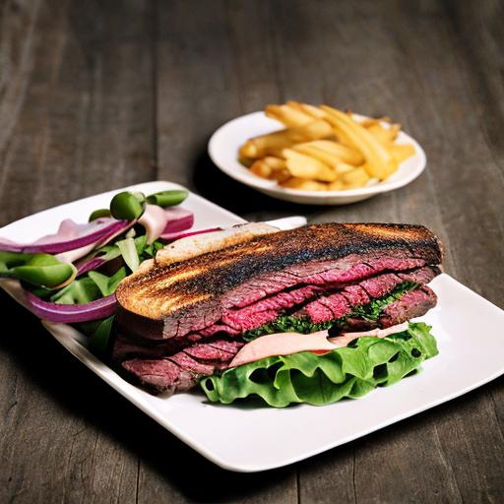
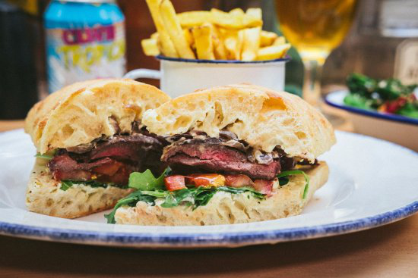
General Deepfake Detection
Real/Fake?
Context. One of the main challenges in deepfake detection is building a detector capable of generalizing to images produced with different generation methods than those seen at training.
Task. Investigate the generalization capabilities of pretrained self-supervised features for deepfake image detection.
Details. You will experiment with and extend the method presented in this paper. You can start from this code that provides a trained linear classification layer on top of features extracted from CLIP. This model is trained on GAN-generated data. Your tasks will be to:
Test the provided model for classification of deepfake images from latest diffusion models. Specifically, you will use for testing the validation test provided in this challenge. Compare the obtained results with those provided on other diffusion models.
Modify the approach to rely on image features extracted from other powerful image encoders (eg. SAM) instead of CLIP
Train a classifier on top of these features using GAN-data.
Compare the results obtained with CLIP and those obtained with SAM features.
MEDIUM
eoneata@bitdefender.com, ssmeu@bitdefender.com

Slide 10
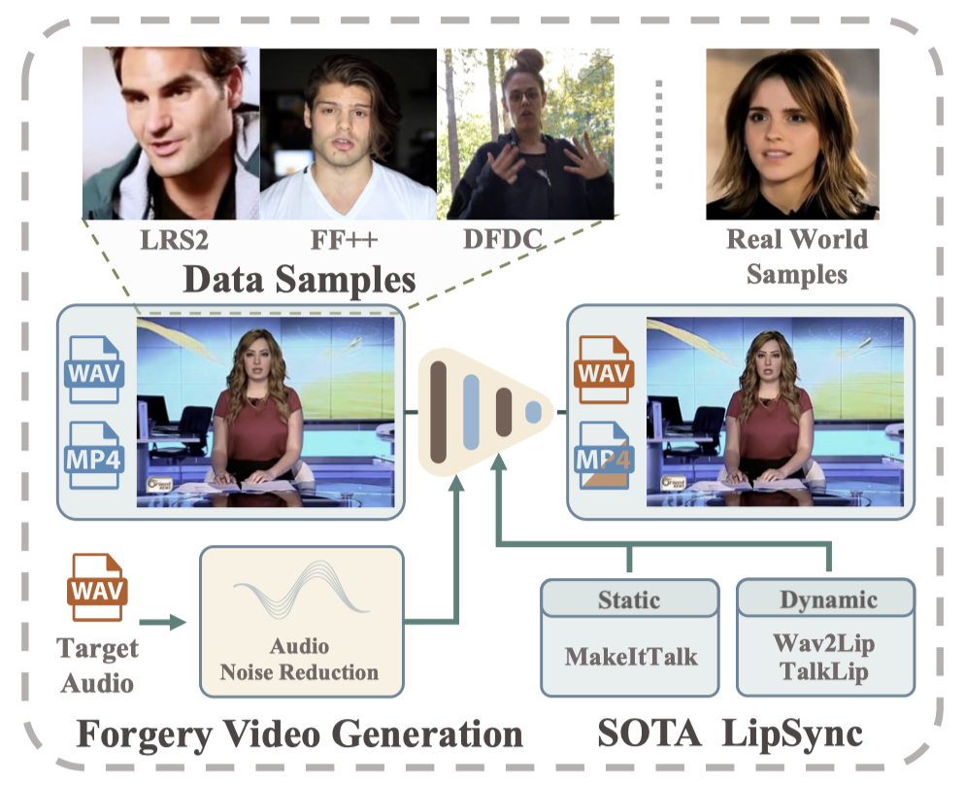
Audio-Video Deepfake Detection using pre trained feature extractor
Resources:
AV-HuBERT
AVLips dataset
Scoring:
80%
Correctly train a simple model in the given setup
Relevant plots for monitoring train/test/validation performance
100%
Propose ways to improve performance
Thorough analysis between multiple approaches (both in terms of model trained and features used)
Task: use a model pre trained on an audio-video task (e.g. AV-HuBERT) as a feature extractor. Using these features, predict either a video is real or fake.
Expectation:
Extract audio-only and video-only features using pre trained feature extractor.
As a baseline, run a simple cosine similarity between the two (dissimilarities may indicate deepfakes).
Use features from different layers to train simple neural networks to predict if a video is real or fake.
HARD
HARD
eoneata@bitdefender.com, dboldisor@bitdefender.com

Slide 11
Cross-domain generalization of modern text encoders
Research q: Do modern BERT-style encoders perform better on cross-domain tasks?
Task: Evaluate models in cross-domain setups (e.g train on general news, test on financial news)
Expectation:
evaluate how ModernBERT performs on cross-domain B when trained on domain A
evaluate if ModernBERT adapts better to cross-domain B when also adding data from B
full experimental setup link
Resources:
ModernBERT
Scoring:
80%
train BERT&ModernBERT on source in- domain A and evaluate on both in- domain and cross domain B
plot confusion matrices for both models for both test sets (in domain and cross-domain)
100%
analysis for both models when further incorporating 10/20/50% cross-domain train data
HARD (EEML)
fbrad@bitdefender.com, dtantaru@bitdefender.com
Notes:
hard vs medium la proiecte NLP mai degraba se refera la nr de experimente decat dificultate per se

Slide 12
Are modern text encoders more robust to noise?
Research q: Are modern BERT-style encoders more robust to input noise?
Task: train models on both original data and original+perturbed data (replaced synonyms, typos, word deletions)
Expectation:
evaluate if ModernBERT is more robust to perturbations when trained on clean vs noised data
for a particular noise, investigate the robustness of model for different levels of corruption (2/5/10% noisy examples)
full experimental setup
Resources:
ModernBERT
Scoring:
80%
train BERT and ModernBERT on several types of perturbations using both clean only data and noise-aware training
plot confusion matrices for all types of training
100%
analysis on different levels of noise
error analysis
HARD (EEML)
fbrad@bitdefender.com, dtantaru@bitdefender.com
Notes:
hard vs medium la proiecte NLP mai degraba se refera la nr de experimente decat dificultate per se

Slide 13
Which Ro LLMs are the best feature extractors?
Research Q: what Romanian LLMs are the best feature extractors on Romanian NLP tasks?
Task: compare several RoLLMs vs general LLMs (LLama3) as feature extractors and train simple MLP classifiers on top of embeddings
Expectations:
evaluate which RoLLM features perform best on downstream tasks?
evaluate which pooling strategy is the best? (avg token, last token, echo embedding etc.)
Experimental setup
Resources:
echo embeddings, summarisation technique
models: mGPT-RO, RoLLama2, LLMic, Llama3
Scoring:
80%
analyse embedding performance for LaRoSeDA and roARC challenge
100%
analyse best pooling strategy
plot embeddings for best model for all 4 pooling techniques
MEDIUM (EEML)
fbrad@bitdefender.com, mdragoi@bitdefender.com

Slide 14
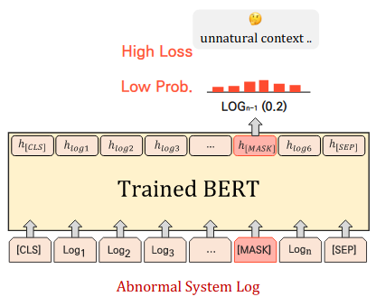
Anomaly detection in network logs
Task: Discriminate anomalous logs (outliers) from benign logs (inliers) using language modelling in unsupervised or self-supervised fashion
Expectation:
Use a RNN (LSTM/GRU) or a Transformer Model (BERT) to learn the inlier distribution
Compute an anomaly metric for the test samples and evaluate the model using ROC-AUC between your anomaly scores and dataset labels
Dataset:
CICIDS2018: https://www.unb.ca/cic/datasets/ids-2018.html
Resources:
RNN for log anomaly detection: https://arxiv.org/pdf/1803.04967.pdf
LAnoBERT: https://arxiv.org/pdf/2111.09564.pdf
OE: https://arxiv.org/pdf/1812.04606.pdf
Scoring:
80%
Correctly train a simple model in the given setup
Correct plots for train/test splits
100%
Obtain good performance
Analyze anomaly detection rate based on outlier class (CICIDS2018 labels: Bruteforce attack, DoS attack, Botnet attack etc.)
Comparison: split data by timestamp (test on different period than the train data) vs random split
Bonus: Outlier Exposure
Anomaly score computation (Source: LAnoBERT)
MEDIUM
mdragoi@bitdefender.com

Slide 15
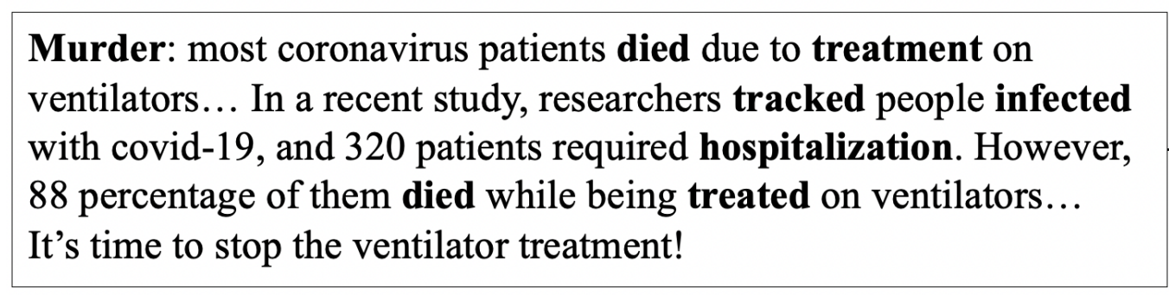
Conspiracy detection PAN 2024
Task: given a text, detect if it’s conspiracy or public messaging
Resources: https://pan.webis.de/clef24/pan24-web/oppositional-thinking-analysis.html
Grading guidelines
70% - finetune multilingual BERT
100% - compare multilingual to language specific models (BERT/BETO)
perform feature analysis
experimental setup link
conspiratorial text
critical text
MEDIUM
fbrad@bitdefender.com, ipintilie@bitdefender.com

Slide 16
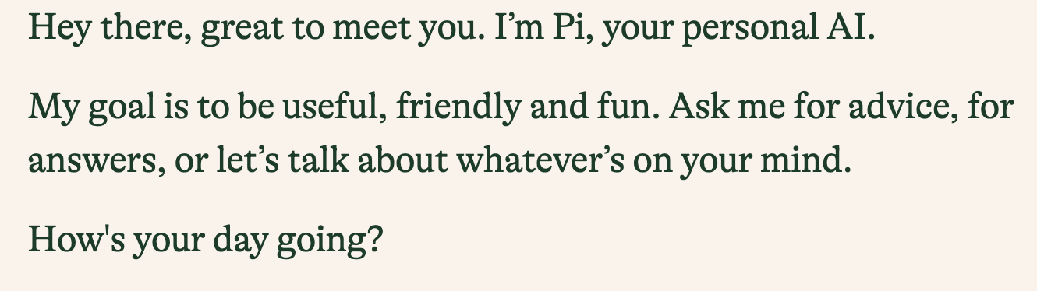
Detect human or machine text
Task: given a text, determine if it was generated by a model or written by a human (2 classes)
Resources
paper:
datasets: PAN, CodaLab
experimental setup link
Grading guidelines
70% - finetune BERT and perform evaluate it cross-domain
100% - perform feature analysis to understand domain-specific cues and address them
machine generated
human
MEDIUM
fbrad@bitdefender.com, ipintilie@bitdefender.com

Slide 17
Steps for the Project
Select a project, team of 2 (hard deadline for choosing project: April 2)
If you are not the first team for a project, ask the mentor if you can choose it
Follow the instructions from your mentor
Read the Related Work
Choose a Dataset
Implement several Baselines in Pytorch
Comparative Analysis - variations for:
Architecture
Number of parameters
Optimization, cost function
Poster for the Project (presented in the final week)
Bonus: Submit for eeml.eu (deadline: March 31 - may be extended for 1 week)
Mandatory: Deep Learning approach for the chosen problem

Slide 20
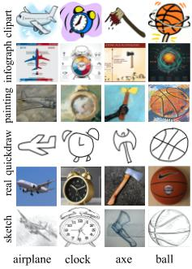
Why do foundational models generalize?
Goal
Q: Why do foundational models embeddings generalize to unseen data distributions(style)? https://arxiv.org/abs/2310.09562 (not due to train-test similarity)
Datasets
Multi-env dataset benchmarks: WILDS, DomainBed
Grading guidelines
50% - fine-tune with 2 methods
80% - fine-tune with 2 methods + a few from 2
100% - fine-tune with 3 methods + most from 2
Bonus*: Test other classification tasks (identify the style). Do fine-tune methods still generalize well?
Fine-tune foundational models with different methods
Linear probing
CLIPood
FLYP
AutoFT (no code yet)
In-depth analysis of features (what is the best embedding/why?)
Visualization TSNE/PCA for features
Visualization OTDD/KL dist for distributions
Alignment vs uniformity
Bonus**: Test methods for better OOD generalization in the embedding space (e.g. Lisa/Mixup/VRex)
ssmeu@bitdefender.com, eoneata@bitdefender.com
Notes:
TODO: GOAL

Slide 21
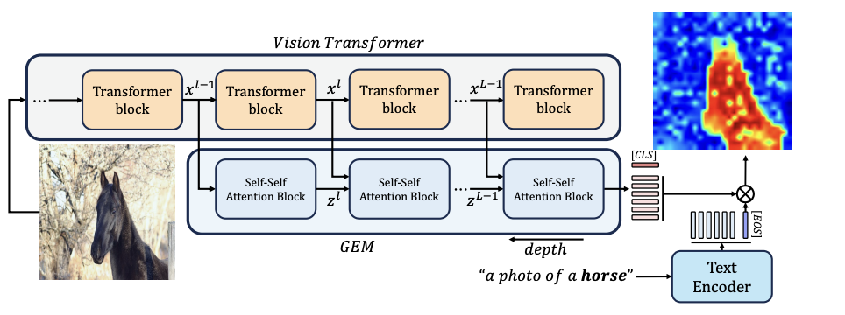
Weakly Supervised Localization with CLIP
Context: Recently, large pretrained (text-images) models (e.g. CLIP) have shown remarkable transfer capabilities. In this project we investigate whether it is possible to implicitly localize various objects described by text.
Task: Analyze the zero-shot localization capabilities of CLIP models using 3 methods on COCO dataset:
Grad-CAM: Visual Explanations from Deep Networks via Gradient-based Localization (GradCam-CLIP example)
Grounding Everything: Emerging Localization Properties in Vision-Language Transformers
Interpreting CLIP's Image Representation via Text-Based Decomposition
Image from: Grounding Everything: Emerging Localization Properties in Vision-Language Transformers, Walid Bousselham, Felix Petersen, Vittorio Ferrari, Hilde Kuehne (CVPR 2024)
eoneata@bitdefender.com, ssmeu@bitdefender.com

Slide 22
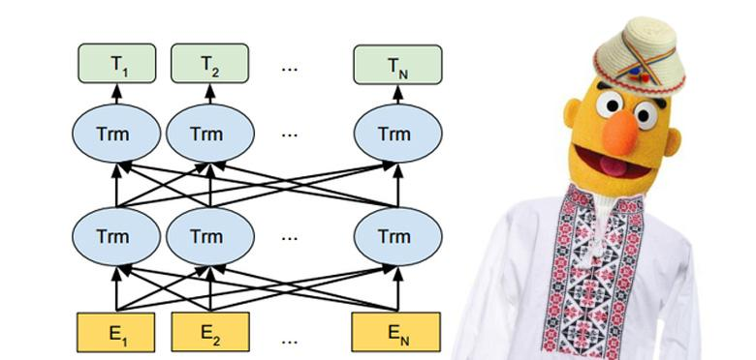
Self-Supervised Learning: Text Features from Language Modelling
Goal
Train a BERT/Romanian BERT language model on a romanian corpus
Transfer knowledge to a downstream task
Datasets
OSCAR (pretraining), LiRo (pretraining, target task)
Links
https://oscar-corpus.com/post/oscar-v22-01/
https://lirobenchmark.github.io/
https://arxiv.org/pdf/2009.08712.pdf
Grading guidelines
80% - finetune BERT on classification task directly
100% - domain-adaptive pretraining, followed by finetuning on classification task
Bonus: Submit a model to LiRo, compare several LM models
fbrad@bitdefender.com, mdragoi@bitdefender.com

Slide 23

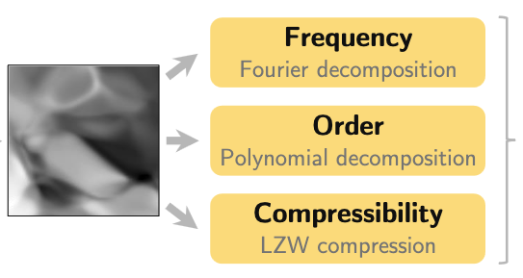
Estimator complexity in RL
Context
Neural networks exhibit training difficulties in Deep Reinforcement Learning
We hypothesize that these issues are correlated with complexity measures
Task
Train neural network value-function estimators in the policy evaluation setting under the following objectives / loss functions:
TD(0)
Monte-Carlo returns
Regression to the true value function
Measure their frequency, polynomial order and compressibility measures of complexity and compare given the loss function
Links
Neural redshift: random networks are not random functions
The primacy bias in deep reinforcement learning
Architecture
Loss function
florin.gogianu@gmail.com

Slide 24
Images courtesy of...
https://20bn.com/datasets/jester
https://github.com/maximecb/gym-minigrid
https://www.elmundotech.com/2015/02/25/googles-deep-mind-creates-an-ai-system-to-beat-video-games-by-itself/
https://aws.amazon.com/blogs/machine-learning/detecting-fraud-in-heterogeneous-networks-using-amazon-sagemaker-and-deep-graph-library/
https://www.dynamicciso.com/dark-nexus-the-evolving-iot-botnet-targets-variety-of-devices-says-bitdefender-research/
https://studentwork.prattsi.org/infovis/visualization/amazon-product-co-purchasing-network-information-visualization/
https://github.com/tkarras/progressive_growing_of_gans

